Slide 1

Accounting Information System
2
Day
#2
Chapter
UAA – ACCT 201 Principles of Financial Accounting Dr. Fred Barbee

Slide 2
Accounting Information System
2
Day
#2
Chapter
First . . . A brief review of Day #1 Topics.

Slide 3

Learning Accounting
If you want to learn accounting, you learn it one concept at a time, one principle at a time.

Slide 4
The Accounting System:
A Conceptual Overview
Operating Environment
Entity B
Entity C
Business Entity A
System Inputs:
Measurable
Transactions
and Events
Process and
Summarize
System Outputs:
Financial
Statements
and Reports
Entity D
Entity E

Slide 5
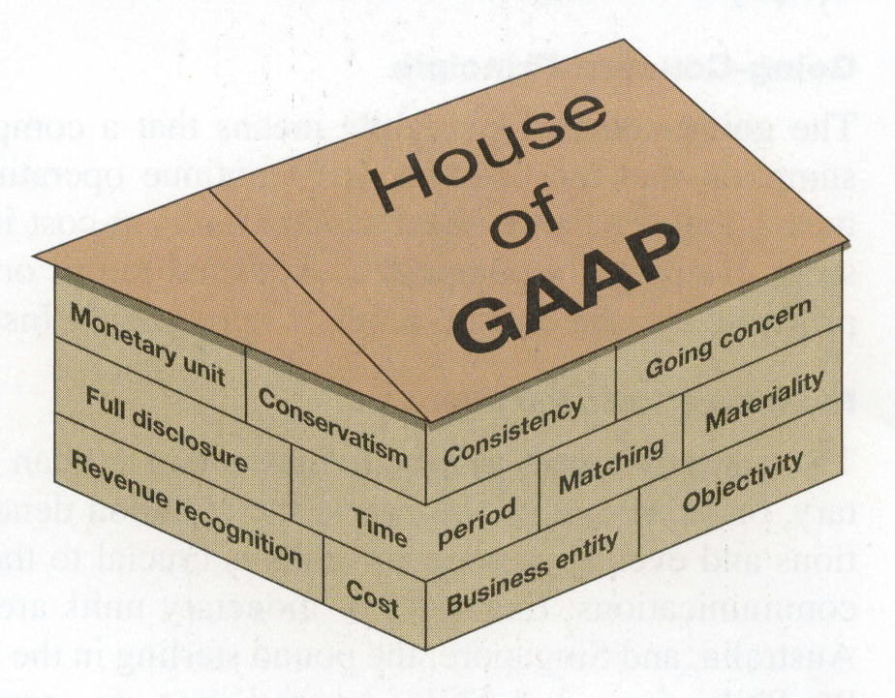
A business continues operation instead of being closed or sold.
Financial Statement information is supported by independent, unbiased evidence.
A business is accounted for separately from its owner(s).

Slide 6
Express transactions and events in monetary units.
Financial statements are based on actual costs incurred in business transactions.

Slide 7




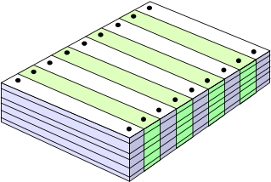

The Accounting Process
Exh.
2.2
Source documents
Transaction or event
Analysis
Reporting
Trial balance
Recording & posting

Slide 8

Account Title
Left Side
Right Side

Slide 9
The Formal Account
Account Title |  |  |  |  | Account No. ###
Date |  | Item | Post Ref | Debit | Credit | Balance
 |  |  |  |  |  | Debit | Credit

Slide 10
Assets
Liabilities
Owners’
Equity
=
+
Capital
Stock
Retained
Earnings
The Accounting Equation
A = L + OE
Revenue
Expenses
-
=
Net
Income

Slide 11
Analyzing Transactions
Analyze the transaction and its source.
Identify the impact of the transaction on account balances.
Identify the financial statements that are impacted by the transaction.

Slide 12
Exercise 2-5
2
Chapter
Identifying effects of transactions on accounting equation
Learning Objectives: A1 (p. 84)

Slide 13
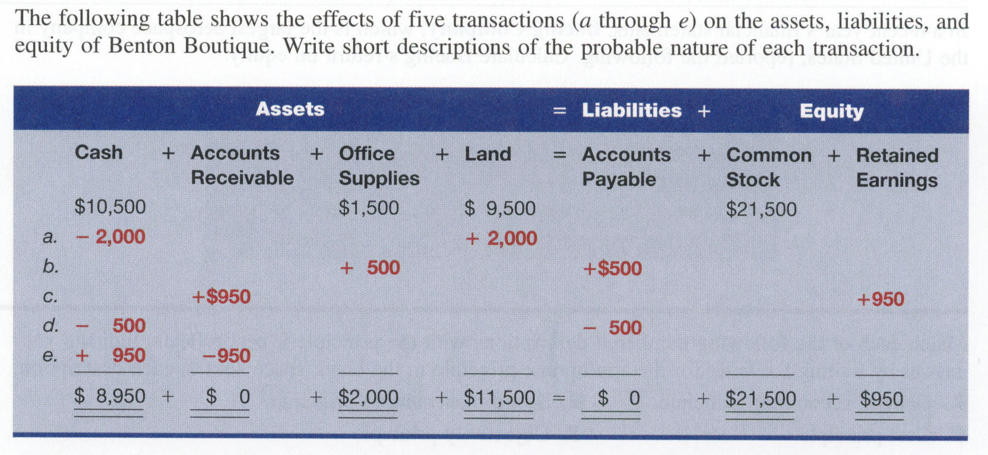
Exercise 2-5

Slide 14
Accounting Information System
2
Chapter
Text Section: Processing and Analyzing Transactions (p. 52)

Slide 15


Learning Objective
C6
  Describe a ledger and a chart of accounts.
Conceptual

Slide 16
Debits and
Credits
ACCT 201 ACCT 201 ACCT 201

Slide 17
Learning Objective
C7
  Define debits and credits and explain their role in double-entry accounting.
Conceptual

Slide 18

Debits and Credits
The debit/credit convention or coding system is very simple.
Do not make it difficult because you cannot accept its simplicity.

Slide 19
Let’s . . .
ACCT 201 ACCT 201 ACCT 201
. . . At Debits

Slide 20
Debits
Debit comes from Latin and merely means “left,” or the “left-hand” side of an account. Abbreviated “DR.”

Slide 21
Account Title
Left Side
We need to stop here and change our way of thinking!
Debit Side

Slide 22

Symbolically, let’s erase that memory
C:\memory\debit\erase *.*
All files in directory will be deleted
Are you sure (Y/N)?

Slide 23
Let’s . . .
ACCT 201 ACCT 201 ACCT 201
. . . At Credits

Slide 24
Credits
Credit also comes from the Latin, and means “right,” or the “right-hand” side of an account. Abbreviated “CR.”

Slide 25
Account Title
Right Side
Let’s stop here and modify our thinking – at least for this class!
Credit Side

Slide 26
Symbolically, let’s erase that memory
C:\memory\credit\erase *.*
All files in directory will be deleted
Are you sure (Y/N)?

Slide 27

So, how can we use this?
That’s a good question!

Slide 28
Accounts actually provide two equalities or balances . . .

Slide 29
Let’s . . .
ACCT 201 ACCT 201 ACCT 201
At the first equality

Slide 30
The algebraic relationship in the fundamental accounting model.
Assets
ACCT 201 ACCT 201 ACCT 201
=
Liabilities
Owners’ Equity
+

Slide 31
Account Title
Debit
Credit
ACCT 201 ACCT 201 ACCT 201
Always

Slide 32
=
Assets
DR
CR
Liabilities
+
+
-
Owners’ Equity
DR
CR
-
+
DR
CR
-
+

Slide 33
The Second Equality . . .
Debits
Credits
=
ACCT 201 ACCT 201 ACCT 201
The algebraic relationship between account increases and decreases.

Slide 34
Debit-Credit Rules . . .
Account
Inc.
Dec.
Assets
Debit
Credit
Liabilities
Credit
Debit
Owners’ Equity
Credit
Debit
Revenue
Credit
Debit
Expenses
Debit
Credit

Slide 35
Debit-Credit Rules . . .
Debits
Credits
Increase
Assets
Expenses
Liabilities
Equity
Revenue
Decrease
Liabilities
Equity
Revenue
Assets
Expenses

Slide 36
Basic Facts About Accounts

Slide 37

For every transaction there must be at least one debit and one credit;
ACCT 201 ACCT 201 ACCT 201

Slide 38

Debits must always equal credits for each transaction, and;
ACCT 201 ACCT 201 ACCT 201

Slide 39

Debits are always entered on the left side of an account and credits on the right side.
ACCT 201 ACCT 201 ACCT 201

Slide 40
Perhaps These
Will Help
ACCT 201 ACCT 201 ACCT 201

Slide 41

ncrease
ebits
IDEA
xpenses
ssets

Slide 42

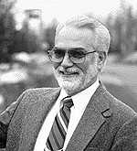
evenues
quity
RELIC
iabilities
ncrease
redits

Slide 43
After Eating Dinner
Let’s Read the Comics
Accounts increased with a debit:
Assets
Expenses
Dividends
Accounts increased with a credit:
Liabilities
Revenues
Capital
ACCT 201 ACCT 201 ACCT 201

Slide 44
Learning Objective
P1
  Record transactions in a journal and post entries to a ledger.
Procedural

Slide 45


Steps in Processing Transactions
=
+
Assets
Liabilities
Equity
Step 1: Examine source documents.
Step 2: Analyze transactions.
We saw these steps earlier. Now, let’s look at some additional ones.

Slide 46
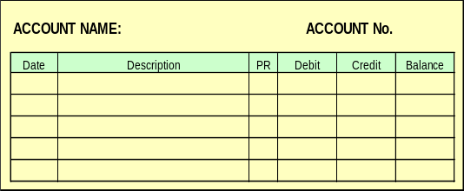
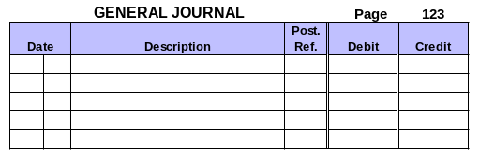
Steps in Processing Transactions
=
+
Assets
Liabilities
Equity
Step 1: Examine source documents.
Step 2: Analyze transactions.
Step 5: Prepare a trial balance.
Step 3: Record transactions in a journal.
Step 4: Record the journal information in a ledger.

Slide 47
The Journal
ACCT 201 ACCT 201 ACCT 201
General Journal |  |  |  |  | Page 1
Date |  | Description | PR | Debit | Credit
Jan | 6 | Art Supplies |  | 1,800
 |  | Office Supplies |  | 800
 |  | Accounts Payable |  |  | 2,600
 | Purchase of art and office supplies on credit
Notes:
Journals
A journal contains a chronological record of the transactions of a business. Because each transaction is initially recorded in a journal before being entered in the ledger, a journal is called a book of original entry.
Here every business transaction is analyzed for its effects upon the entity. These effects are expressed in terms of debit and credit - the inputs of the accounting system.

Slide 48
Journals . . .
A journal contains a chronological record of the transactions of a business.
Notes:
Journals
A journal contains a chronological record of the transactions of a business. Because each transaction is initially recorded in a journal before being entered in the ledger, a journal is called a book of original entry.
Here every business transaction is analyzed for its effects upon the entity. These effects are expressed in terms of debit and credit - the inputs of the accounting system.

Slide 49
Advantages
Sets forth transactions of each day.
Records transactions in chronological order.
Shows the analysis of each transaction in terms of debit and credit effects.
Supplies an explanation of each transaction

Slide 50
Advantages
Serves as a source for future reference to accounting transactions.
Removes lengthy explanations from the ledger accounts.
Makes posting the ledger at convenient times possible.

Slide 51
Advantages
Assists in keeping the ledger in balance.
Aids in tracing errors.
Promotes the division of labor.

Slide 52
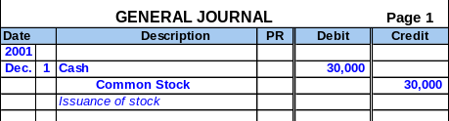
General Journal for FastForward
Transaction Date
Titles of Affected Accounts
Transaction explanation
Dollar amount of debits and credits

Slide 53
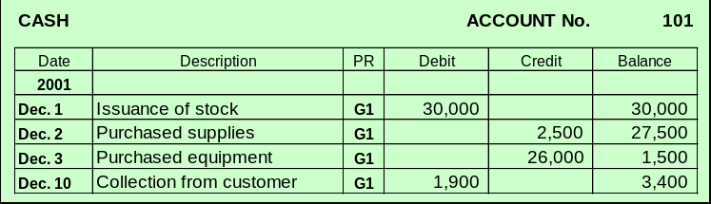
Balance Column Ledger
T-accounts are useful illustrations, but balance column ledger accounts are used in practice.

Slide 54
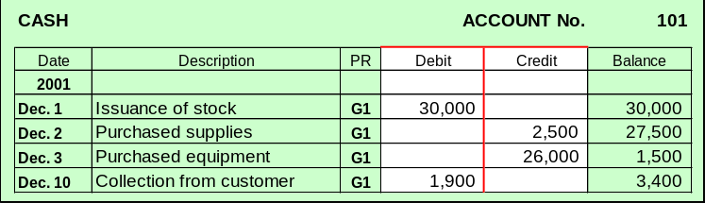
Balance Column Ledger
Note the the t-account tool is derived from the debit and credit columns of the ledger.

Slide 55
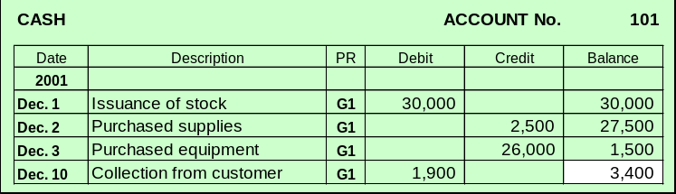
Balance Column Ledger
Exh.
2.16
The last line in the balance column shows the current balance in the account.

Slide 56
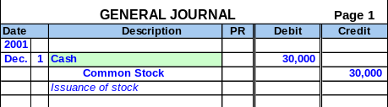
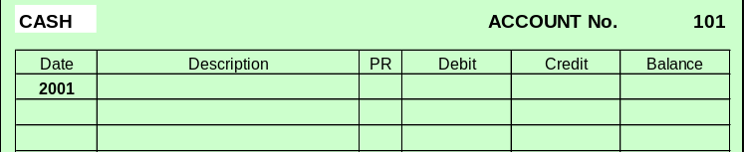
Posting Journal Entries - Example
1
Identify the account.

Slide 57
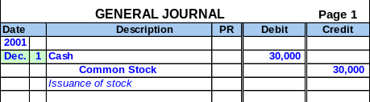
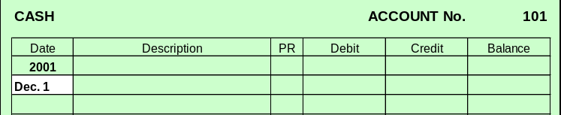
Posting Journal Entries - Example
Enter the date.
2

Slide 58
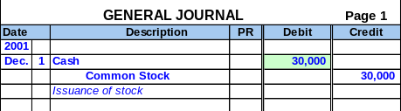
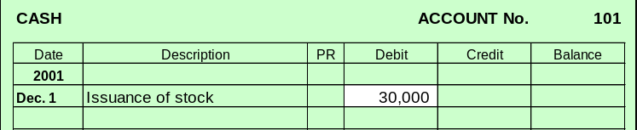
Posting Journal Entries - Example
Enter the amount.
3

Slide 59
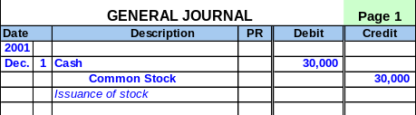
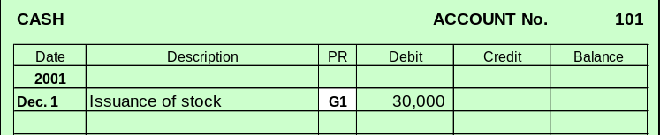
Posting Journal Entries - Example
Enter the journal reference.
4

Slide 60
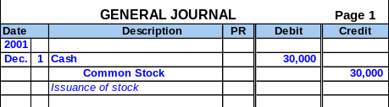
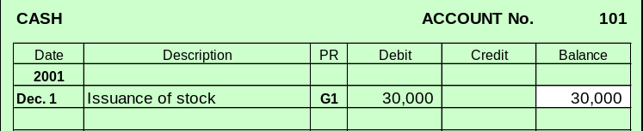
Posting Journal Entries - Example
Compute the balance.
5

Slide 61
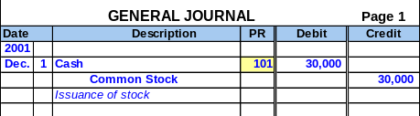
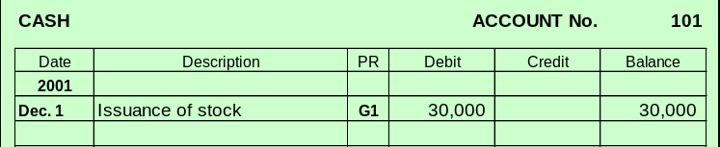
Posting Journal Entries - Example
Enter the ledger reference.
6

